Slide 1
Principles of Data and Error Analysis in Engineering Measurements
Miodrag Bolic
Associate Professor
School of Electrical Engineering and Computer Science (EECS)
Faculty of Engineering

Slide 2
Some of my research projects
Monitor to capture daily activities and vital signs
Assist with neural interfaces for sensing + neuromodulation

Slide 3
Outline
Motivation
Introduction
Uncertainty framework
Biomedical examples
Confidence intervals and traditional GUM based approach
Bayesian methods and Monte Carlo methods
Application in uncertainty propagation and sensitivity analysis
Bootstrap methods
Application in obtaining confidence intervals in data fitting and for estimation for time-series
Conclusion

Slide 4
Motivation: Unresolved uncertainty questions
How accurate are the resulting predictions?
Are the mathematical and physical models correct?
In general, how can we establish ”error bars” on the results?
How can we use the knowledge of uncertainties during calibration for prediction?
In systems with multiple processing steps, how do the uncertainties propagate from one step to another?
Notes:
From Introduction to uncertainty representation and propagation, Gianluca Laccarino
AVT--‐193 Short Course on Uncertainty Quantification

Slide 5
Uncertainty evaluation in instrumentation, processing and data analysis
Current status
Not commonly performed
Current approaches mainly based on metrology (GUM)
Deal mainly with propagation of uncertainty
Opportunities
Advances in computing hardware and algorithms have dramatically improved the ability to simulate complex processes – sampling methods
Significant developments in mathematical and software tools for uncertainty quantifications in other areas
Focus is expanded to sensitivity analysis, calibration of models, uncertainties in predictions and decision making

Slide 6
Goal
Introduce an uncertainty framework
Show several biomedical applications
Focus on resampling methods
Bootstrap, Monte Carlo

Slide 7
Outline
Motivation
Introduction
Uncertainty framework
Biomedical examples
Confidence intervals and traditional GUM based approach
Bayesian methods and Monte Carlo methods
Application in uncertainty propagation and sensitivity analysis
Bootstrap methods
Application in obtaining confidence intervals in data fitting and for estimation for time-series
Conclusion

Slide 8
Uncertainty quantification
Uncertainty Quantification (UQ) aims at developing rigorous methods to characterize the impact of ”limited knowledge” on quantities of interest.
Statistics of an outcome of interest, such as its expectation and the variance, commonly requires the evaluation of integrals
Uncertainty is usually summarized through confidence intervals
Notes:
Limited knowledge – can be resuced by repeated experiments – epistemic
Aliatory uncertainty is natural variability and cannot be reduced – for example if we have wind velocity as an input to the model it changes over time
Regarding the characterization of uncertainties both direct and inverse methods are at disposal. Among the direct methods, the experimental observations, theoretical arguments and also expert opinions are the principal; inference and calibration are, instead, the fundamental techniques to translate observed data in statistical input parameters. The propagation process is the ensemble of operations which allows to obtain the uncertain outputs prescribing, to the uncertain model, the uncertain inputs. In this work the focus is totally devoted to aleatory, i.e. stochastic uncertainties, so in this case the probability framework plays a special role not only for the characterization of the sources of uncertainties, but also for their propagation. The final UQ step involves the analysis of the ensemble of output quantities of interest in term of probability distributions, cumulative distributions or other statistic characterization of data. Moreover, also sensitivity analysis (SA) of the data could be of interest. In the Part II of this thesis examples, of how the SA analysis can be employed to improve the understanding of complex system, will be provided. However, even if they are related, it is important to underline the difference between UQ and SA. Sensitivity analysis investigates the connection between inputs and outputs of a model and, in particular, it makes possible to relate the variability of the outputs to the variability of the inputs. SA does not need input data and can be conducted on purely mathematical analysis, while the UQ, given a system, aims to quantify its output uncertainty. The meaning of SA in the design context appears clear: large variations of some (identified) parameters generate large variations of the outputs. In the UQ context, however, a large sensitivity of a parameter is not strictly connected to large
uncertainties. In fact uncertainties related to input parameters, to which the system is greatly sensitive, could be so small to induce no uncertainty on the outputs at all. Moreover, it could be important determining how the uncertain structure of all the inputs maps the uncertain structure of all the outputs. In this case the SA is named global SA and its importance becomes crucial in the light of improving the quality of the model itself identifying the sources of a lack of knowledge. For instance, in the case of complex coupled physics phenomena, a global SA can indicate the relevant physical experiments to conduct to most reduce the epistemic uncertaint
From https://tel.archives-ouvertes.fr/tel-00954413/file/GERACI_GIANLUCA_2013_RED.pdf

Slide 9
Framework 1 - decision making under uncertainty
Model and parametric
uncertainties
Computational
uncertainties
Real system
Mathematical model
Computational model
Verification
Validation
Prediction
Observations
Measurement
uncertainties
Decision making
Notes:
Uncertainty Quantification in Engineering Science
Course
Verification. How accurately does the computation solve the underlying
equations of the model for the quantities of interest?
• Validation. How accurately does the model represent reality for the quantities of
interest?
• Uncertainty Quantification (UQ). How do the various sources of error and
uncertainty feed into uncertainty in the model-based prediction of the quantities of
interest?
Modeling phase:
Improve the model
Explore the best as possible different input combinations
Identify the predominant inputs and phenomena in order to priorize R&D
Validation phase:
Reduce prediction uncertainties
Calibrate the model parameters
Practical use of a model:
Prediction: assess a risk of failure
Estimation: optimize system performances and robustness
B. Iooss 11
Venez’ course 2012 – Treatment of uncertainties –
Modeling (or Structural) Uncertainty Arise from assumptions used to build a mathematical model for A. representing the physical system (the real thing) B. representing the interactions of the system with the environment Comes from the lack of knowledge for the underlying true physics, leading to discrepancies (model bias) between the predictions from the model and the observations (measurements). The model inadequacy is always present and the question is how to select the best models over a family of alternative models introduced to model the same physical phenomenon.
• Parametric Uncertainty Arise from lack of knowledge of the appropriate values of the parameters of a mathematical model. Examples include the material properties of a continuum such as solid or fluid, the properties involved in constitutive laws, the boundary conditions, etc.
Computational (or Algorithmic) Uncertainty linked to the numerical uncertainty arising from the numerical approximations introduced to implement the analysis in a computer. Examples include spatial and temporal discretization of PDEs using finite element methods, finite difference methods or particle methods.
• Measurement uncertainty arises from the variability in the values of the experimental properties due to variability in experimental set up, errors in the measuring equipment, and inaccuracies in the data acquisition system.

Slide 10
Verification determines how well the computational model solves the math-model equations
Validation determines how well the model represents the true physical system
Involves comparisons between QOIs computed by the model and corresponding true, physical QOIs inferred from physical observations or experiments.

Slide 11
Observing nature and predicting events
Observations: we are unable to observe and/or predict nature accurately
the limited accuracy of measurement instruments,
the exceedingly high cost of performing accurate experiments and/or measurements,
the lack of accurate models or the computational need of using simplified ones.
Predictions: the result of a combination of measurements, modeling and simulations
Models are based on certain levels of approximation, introduced to make them manageable

Slide 12
Modeling Approach
Advantages
Concise summary of present knowledge of operation of a particular system
Predict outcomes of modes of operation not easily studied experimentally
Clarify or simplify complex experimental data
Suggest new experiments to advance understanding of a system
Limitations
Models often require many simplifying assumptions
beware of garbage in, garbage out
Validation of model predictions is essential

Slide 13
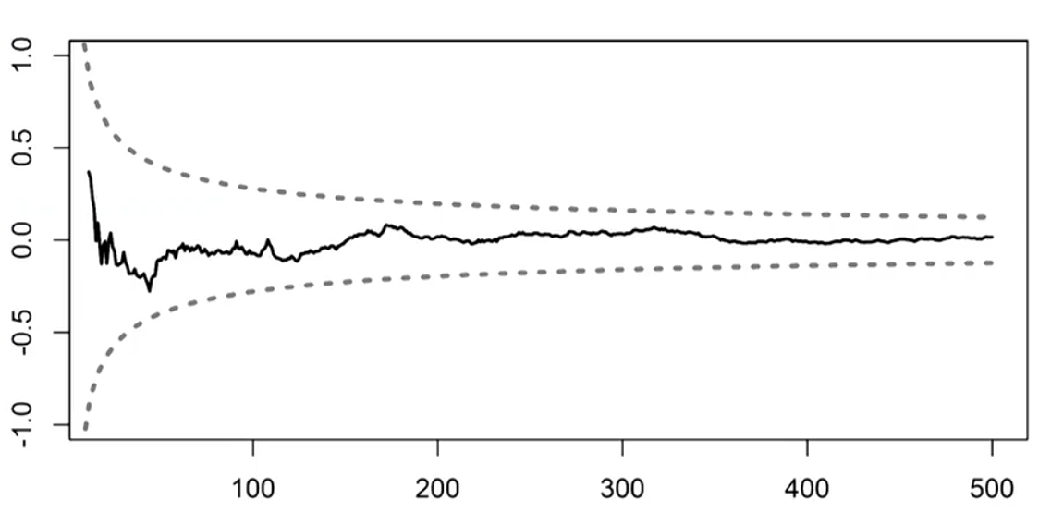
Examples of presenting uncertainty
Standard error
Heart rate is (60 ± 4) beats/minute (mean ± standard error)
Confidence levels
95% confidence for the heart rate is [52,68] beats/minute
Probability distributions
Determining different moments or quantiles
Prediction levels over time
Notes:
Intro to uncertainty quantification: https://nanohub.org/resources/10694

Slide 14
Uncertainty aspects
Historical data
Real-time
data
No data
Sensor
Data
availability
Device
Frequentist
Multiple devices for the same task
Bayesian
Many of these systems
connected to the cloud
Statistical approach
Complexity

Slide 15
Uncertainty – classification based on data availability
Uncertainty propagation when no data is available
Resampling methods
Sensitivity analysis
Uncertainty evaluation when historical data is available
Model fitting and calibration
Bootstrap
Uncertainty evaluation using real time data
Bootstrap for processing radar data
Monte Carlo methods

Slide 16
Framework 2: The workflow of Uncertainty Quantification
Step C’: Sensitivity analysis
Step C: Uncertainty propagation
Step A: Definition of the model
Step B: Quantifying sources of uncertainty
- Modeling with probability distributions
Input
Variables
Uncertain: x
Fixed: u
Model
f(x,u)
Variables
of interest
Y=f(x,u)
Quantity of interest
Probability
CI
Measurement data
Step B’: Model calibration, Parameter estimation
Test data
Step D: Decision and prediction under uncertainty (in real time)
Based on OpenTURNS:
http://www.openturns.org/
Notes:
Michaël Baudin, Anne Dutfoy, Bertrand Iooss and Anne-Laure Popelin, OpenTURNS : An industrial software for uncertainty quantification in simulation, arXiv:1501.05242v2 [stat.CO] 5 Jun 2015.
Resources:
Bigoni, Daniele; Engsig-Karup, Allan Peter, Uncertainty Quantification with Applications to Engineering Problems, Technical University of Denmark
Based on OpenTurns

Slide 17
Step B: Quantification of uncertainty sources
A lot of data
Fitting of probability distributions
Statistical hypothesis test
Few data (n < 10)
Hypothesis on parametric probability distribution
Expert judgement, then Bayesian inference
No data
Expert judgment techniques
Taking into account the dependency between inputs is a
crucial issue in uncertainty analysis
Notes:
Copied from the slides:
Bertrand Iooss, Treatment of uncertainties in numerical simulation, 29/11/2012
Correlations can be taken into account in the uncertainty propagation and sensitivity analysis.
Sometimes we can transform correlated into uncerralaterd variables:
For Normal correlated use Cholesky decomposition
For non-normal correlated variables Nataf transformation can be used – it is implemented in Dakota tool.
Karhunen- Luove expansion is the method based on PCA that is commonly used

Slide 18
Step B’: Model Calibration
Model calibration is the process of adjusting unknown model parameters in order to improve the agreement between model output and observed data
Involves “tuning” values of the parameters of the model to best match the observed data
Methods
Maximum likelihood methods
Model is used with fitted parameters to predict future behavior of the system
Bayesian methods for parameter estimation
the predictions allow for all sources of uncertainty, including the remaining uncertainty over the fitted parameters

Slide 19
Step C: Uncertainty propagation
Aim is to quantify output uncertainties
Allows us to place confidence on model predictions
a first step in providing trust in model predictions.
Metrology: Uncertainty budget
Combine all the uncertainties and then see what components in your systems need to be replaced/improved
Quality control:
Meeting design specification of your device

Slide 20
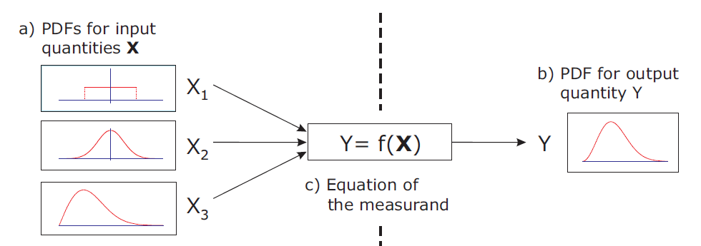
Step C: Propagation of uncertainty
Perturbation methods
the solution is expressed using a suitable Taylor series expansion
Sampling techniques
Monte Carlo based

Slide 21
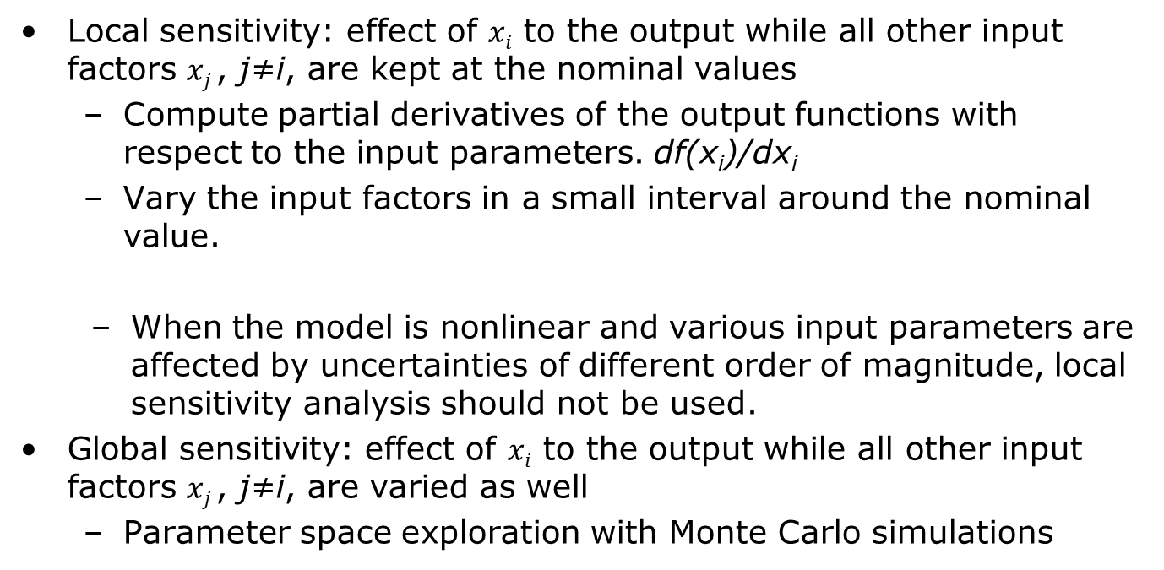
Step C’: Sensitivity analysis
Local sensitivity: effect of $xi$ to the output while all other input factors $xj$, j≠i, are kept at the nominal values
Compute partial derivatives of the output functions with respect to the input parameters. df(x_{i})/dx_{i}
Vary the input factors in a small interval around the nominal value.
When the model is nonlinear and various input parameters are affected by uncertainties of different order of magnitude, local sensitivity analysis should not be used.
Global sensitivity: effect of $xi$ to the output while all other input factors $xj$, j≠i, are varied as well
Parameter space exploration with Monte Carlo simulations
Notes:
Morris Elementary Effects
Perform local sensitivity on the grid and definesensitivity metrics
Sobol indices
Variance based decomposition method

Slide 22
Step C’: Sensitivity analysis
Sensitivity analysis investigates the relationship between inputs and outputs of a model
it makes possible to relate the variability of the outputs to the variability of the inputs.
Does not need input data and can be conducted on purely mathematical analysis
Identifies the most important parameters in the model
Helps reducing the dimension of the model by fixing unimportant parameters
Focus: global variability of the model output, measured by its variance.

Slide 23
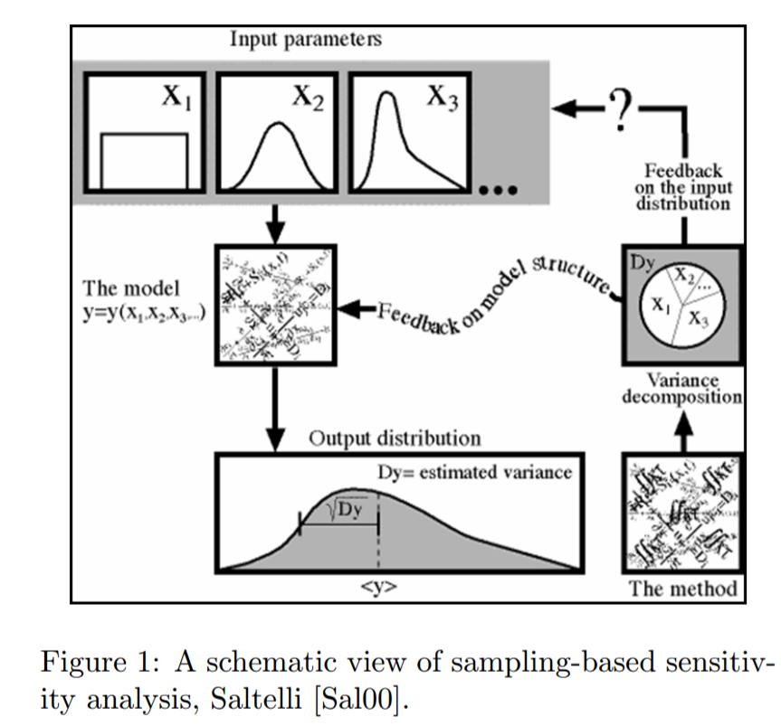
Step C’: Sensitivity analysis

Slide 24
Step D: Confidence intervals for estimation for time series
Non-parametric methods
Bootstrap for time series
Parametric methods
Kalman filters for linear and Gaussian models
Particle filters
Ability to represent arbitrary densities
Adaptive focusing on probable regions of state-space
Dealing with non-Gaussian noise
The framework allows for including multiple models

Slide 25
Example: Modeling blood pressure monitoring
Notes:
File: model and measurement

Slide 26
Framework 2 Example: Modeling blood pressure monitoring

Slide 27
Framework 2 Example: Modeling blood pressure monitoring
Step C’: Sensitivity analysis – reducing the number of param. of the model
Step A: Definition of the model
Step B: Quantifying sources of uncertainty
- Setting ranges and distributions of param.
Input Variables
Uncertain: elasticity of arteries, …
Fixed: age, cuff size
Model
f(x,u)
Quantity of interest
Sys/Dia blood pressure
Arterial stiffness param.
Step B’: Model calibration
– SP 10 standard
Test data
Oscillometric measurement data
Step D: - Estimation of arterial stiffness
- Estimation of Sys/Dia blood pressure with CI
Notes:
Resources:
Bigoni, Daniele; Engsig-Karup, Allan Peter, Uncertainty Quantification with Applications to Engineering Problems, Technical University of Denmark

Slide 28
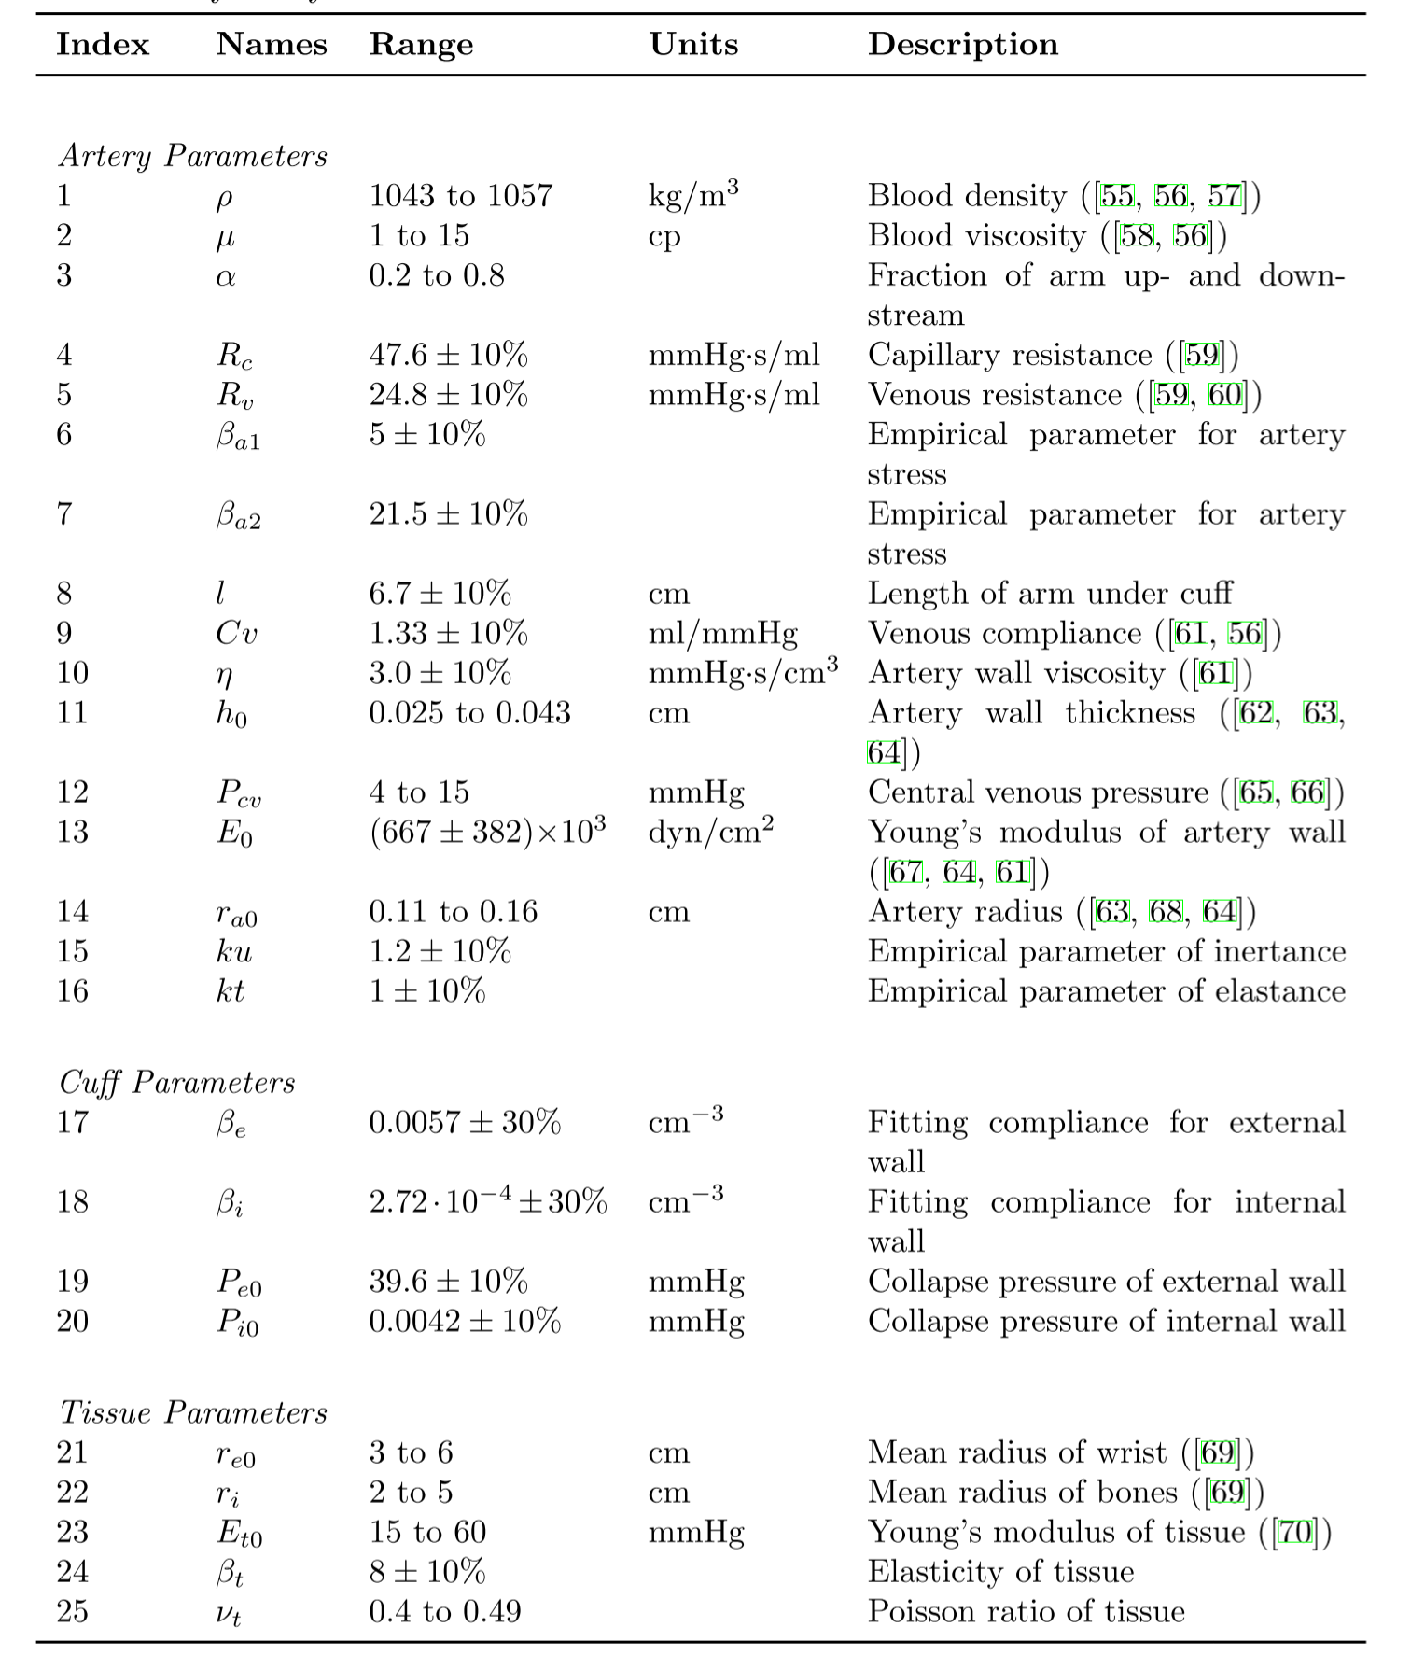
Example Sensitivity Analysis
Mathematical model of the artery, tissue and the cuff
Sensitivity analysis to determine most sensitive parameters of the model
Reduced analysis to 7 parameters
Derived compensation function that include estimation using fixed parameters such as regular BP device and then compensation based on linear regression.
Matthew James, Simplified Model for the Design of an Oscillometric Blood Pressure Measuring System, PhD Thesis, University of Guelph, 2012
Notes:
C:\Users\Bolic\Dropbox\Backup\doc\data quality paper\James_Matthew_20130114_Phd

Slide 29
Uncertainty propagation for pulse oximeter
A. Cysewska-Sobusiak, "Estimation of Uncertainty in Complex Biomeasurements," IEEE Workshop on Advanced Methods for Uncertainty Estimation in Measurement, 2007, pp. 24-29.
Notes:
A. Cysewska-Sobusiak, "Estimation of Uncertainty in Complex Biomeasurements," 2007 IEEE International Workshop on Advanced Methods for Uncertainty Estimation in Measurement, Sardagna, 2007, pp. 24-29.

Slide 30
Framework 2: – Uncertainty propagation for pulse oximeter
Step C: Uncertainty propagation
Step A: Definition of the model
Step B: Quantifying sources of uncertainty
- Distributions of the inputs U_{p1}, U_{o1}, U_{p2}, U_{o2}
Input Variables
Uncertain: U_{p1}, U_{o1}, U_{p2}, U_{o2}
Model
f(U)
Quantity of interest
Saturation+ CI
Step B’: Calibration to determine bias
Test data
Measurement data
Step D: Estimation of Saturation+ CI
Notes:
Michaël Baudin, Anne Dutfoy, Bertrand Iooss and Anne-Laure Popelin, OpenTURNS : An industrial software for uncertainty quantification in simulation, arXiv:1501.05242v2 [stat.CO] 5 Jun 2015.
Resources:
Bigoni, Daniele; Engsig-Karup, Allan Peter, Uncertainty Quantification with Applications to Engineering Problems, Technical University of Denmark

Slide 31
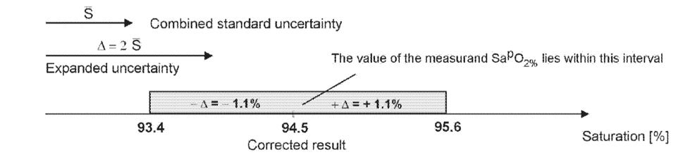
Framework 2 – Uncertainty propagation for pulse oximeter

Slide 32
Applications
Prognostics
Metrology
Uncertainty quantification in complex systems
Probabilistic machine learning
Reliability
Decision making under uncertainty

Slide 33
Prognostics
Prognostic is predicting how long will take until a particular future event or state is reached.
Classification
Reliability base prognostics
Predict mean life of the component
Failure rates
Early detection of anomalous state

Slide 34
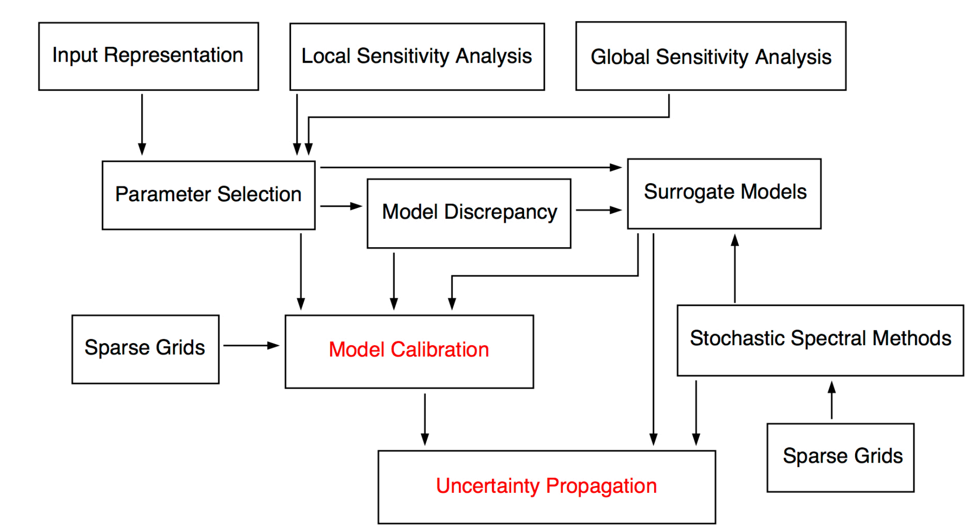
Uncertainty quantification in complex systems

Slide 35
Metrology
The science of measurement, embracing both experimental and theoretical determinations at any level of uncertainty in any field of science and technology
Uncertainty, as defined in the ISO Guide to the Expression of Uncertainty in Measurement (GUM) and the International Vocabulary of Basic and General Terms in Metrology (VIM), is a
"parameter, associated with the result of a measurement, that characterizes the dispersion of the values that could reasonably be attributed to the measurand."

Slide 36
Probabilistic machine learning
Learning can be thought of as inferring plausible models to explain observed data.
Main uses:
Make predictions about future data,
take decisions that are rational given these predictions.
Uncertainty:
Observed data can be consistent with many models, and therefore which model is appropriate, given the data, is uncertain.
Predictions about future data and the future consequences of actions are uncertain.
Zoubin Ghahramani, Probabilistic machine learning and artificial intelligence, Nature, 2015

Slide 37
Decision making under uncertainty
Including various sources of uncertainty into decision making process
Automated decision making systems
Examples
Collision avoidance system
Surveillance systems

Slide 38
Tracking and sensor fusion
How can one combine information from multiple imprecise sensors
What is the accuracy of tracking of the objects
Monte Carlo based filters – particle filters

Slide 39
Typical objectives in the applications
Forward propagation (uncertainty propagation)
Suppose that the uncertainties about the inputs of the model can be summarized in a probability distribution. Given that, determine the induced probability distribution at the output
Reliability
Given information about the input and forward process, determine the failure probability (probability that the output value is greater than some threshold)
Prediction
Inverse problem
State estimation (for quantity changing in time)
Parameter identification (usually for quantity non-changing)
Learning
Model reduction – consider another function that approximates our model

Slide 40
Outline
Motivation
Introduction
Uncertainty framework
Confidence intervals and traditional GUM based approach
Bayesian methods and Monte Carlo methods
Application in uncertainty propagation and sensitivity analysis
Bootstrap methods
Application in obtaining confidence intervals in data fitting and for estimation for time-series
Conclusion

Slide 41
Confidence Intervals
The value of the statistic in the data sample (eg., mean, median, etc.)
point estimate ± (measure of how confident we want to be) × (standard error)
From a Z table or a T table, depending on the sampling distribution of the statistic.
Standard error of the statistic.

Slide 42
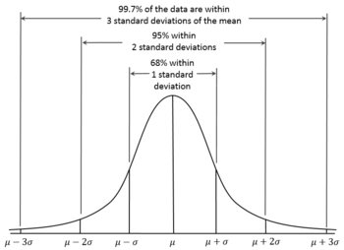
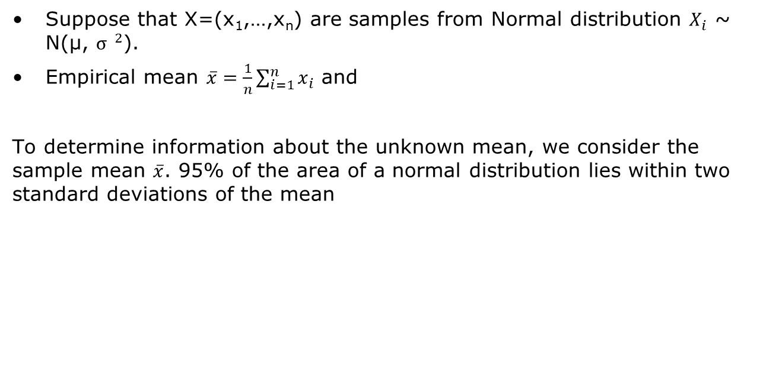
Confidence interval for the mean of Normal distribution with σ known
Suppose that X=(x₁,…,x_{n}) are samples from Normal distribution $X_{i}$ ~ N(µ, ${σ }^{2}$).
Empirical mean $\overline{x}=\frac{1}{n}\sum_{i=1}^{n}{x_{i}}$ and
To determine information about the unknown mean, we consider the sample mean $\overline{x}$. 95% of the area of a normal distribution lies within two standard deviations of the mean

Slide 43
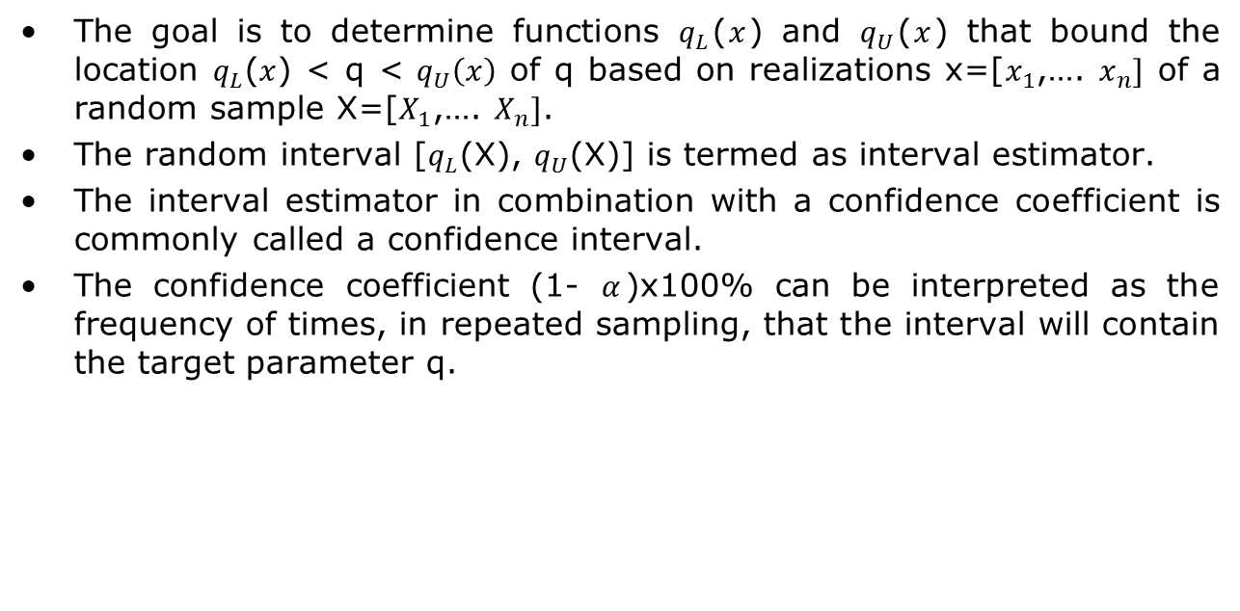
Confidence interval
The goal is to determine functions $q_{L}$($x$) and $q_{U}$($x$) that bound the location $q_{L}$($x$) < q < $q_{U}\left(x\right)$ of q based on realizations x=[$x_{1}$,…. $x_{n}]$ of a random sample X=[$X_{1}$,…. $X_{n}]$.
The random interval [$q_{L}$(X), $q_{U}$(X)] is termed as interval estimator.
The interval estimator in combination with a confidence coefficient is commonly called a confidence interval.
The confidence coefficient (1- $α$)x100% can be interpreted as the frequency of times, in repeated sampling, that the interval will contain the target parameter q.
Notes:
Ralph C. Smith, “Uncertainty Quantization, Theory, Problems and Applications,” SIAM, 2014.

Slide 44
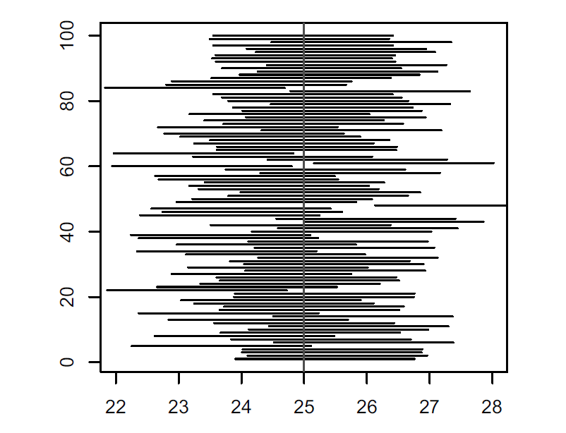
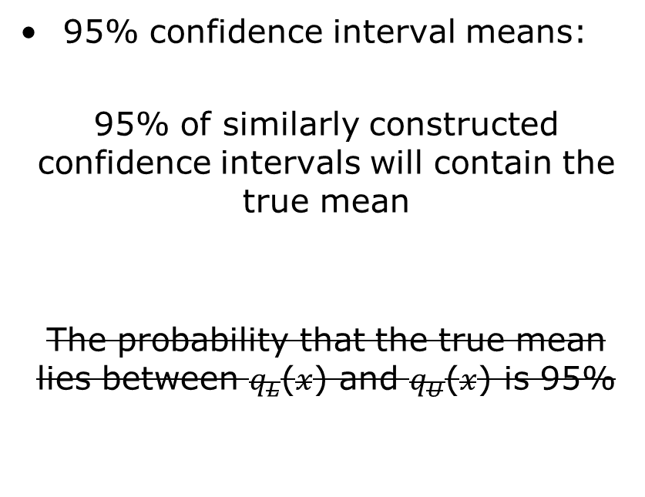
Confidence intervals interpretation
95% confidence interval means:
95% of similarly constructed confidence intervals will contain the true mean
The probability that the true mean lies between $q_{L}$($x$) and $q_{U}$($x$) is 95%

Slide 45
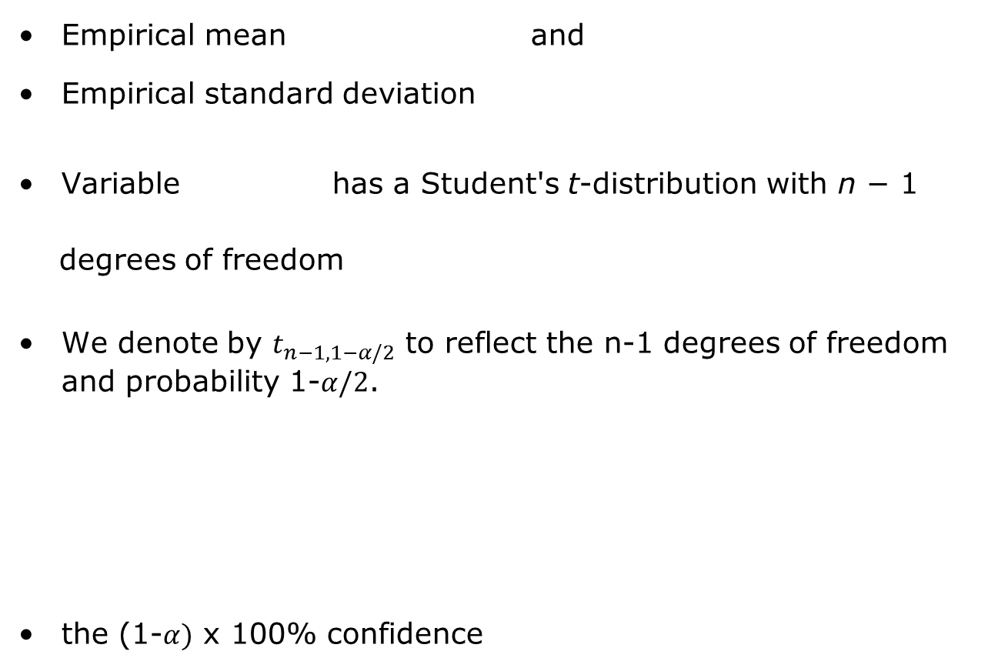
Confidence interval for the mean of Normal distribution with σ unknown
Empirical mean and
Empirical standard deviation
Variable has a Student's t-distribution with n − 1
degrees of freedom
We denote by $t_{n−1,1−α/2}$ to reflect the n-1 degrees of freedom and probability 1-$α/2$.
the (1-$α)$ x 100% confidence
Notes:
If X is sampled from the Normal distribution than
has a standard normal distribution (i.e. normal with expected value 0 and variance 1), and the random variable
{\displaystyle {\frac {{\bar {X}}-\mu }{S/{\sqrt {n}}}}}(where σ has been substituted for S) has a Student's t-distribution with n − 1 degrees of freedom.

Slide 46
Confidence interval for the mean of Normal distribution with σ unknown, cont.
A 95% confidence interval for μ:

Slide 47
GUM-base approach Types of uncertainty
An error δ = measured value– “true” value of density
An uncertainty u is an estimate of an interval ±u that should contain an error.
GUM categorization :
Type A: “method of evaluation of uncertainty by the statistical analysis of series of observations”
Type B: “method of evaluation of uncertainty by means other than the statistical analysis of series of observations”

Slide 48
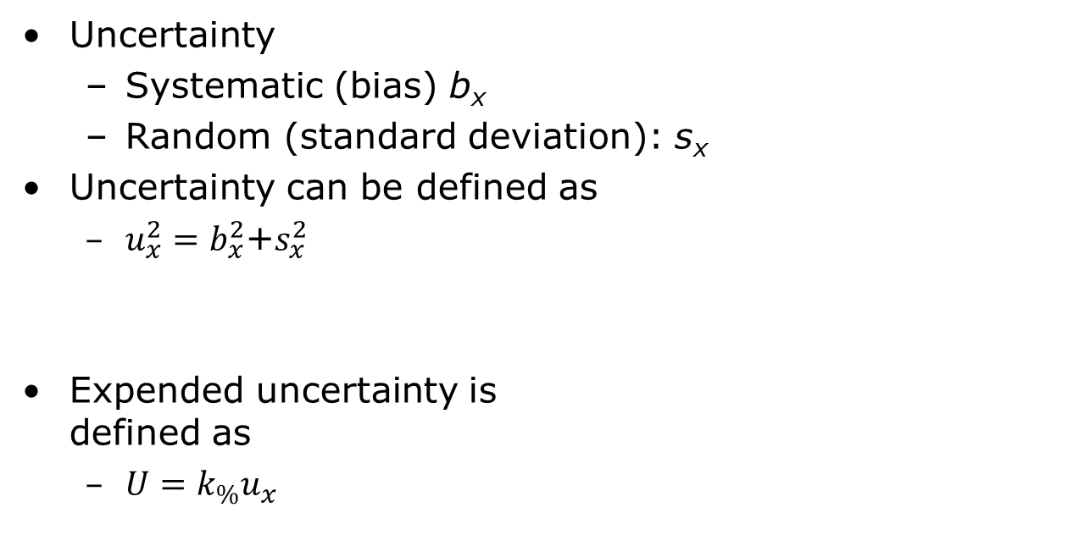
Expended Uncertainty
Uncertainty
Systematic (bias) b_{x}
Random (standard deviation): s_{x}
Uncertainty can be defined as
$u_{x}^{2}=b_{x}^{2}$+$s_{x}^{2}$
Expended uncertainty is defined as
$U=k_{\%}u_{x}$

Slide 49
Definitions
Standard uncertainty
uncertainty of the result of a single type of measurement includes Type A and/or Type B uncertainties
Expanded uncertainty
the standard uncertainty multiplied by a coverage factor
Standard error SE
Standard deviation of the sample statistics

Slide 50
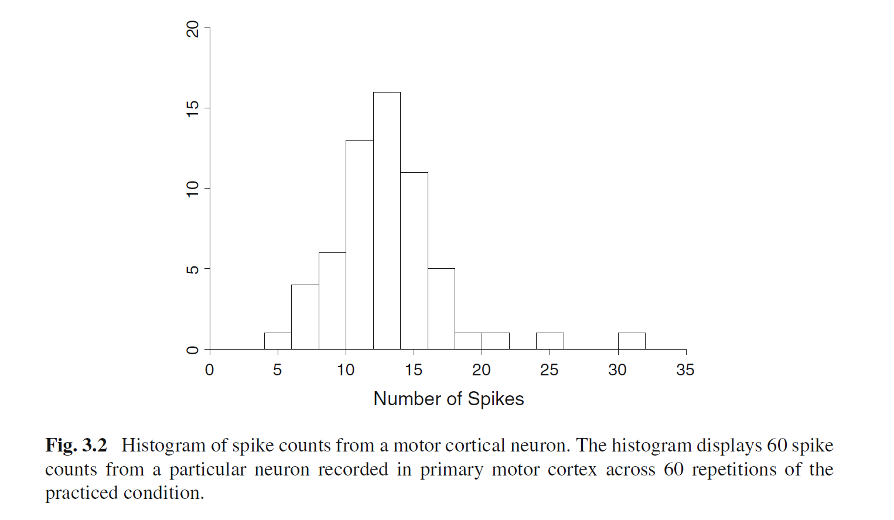
Example – Spike counts from a motor cortical neuron
Button pressing task
The number of spikes from a single neuron is measured in the period of 600 ms
Mean: 13.6 spike per 600ms or 22.7 spikes per second
Confidence intervals?
R. E. Kass, et. al., “Analysis of Neural Data,”
Springer 2014
Notes:
Figure 3.2 displays a histogram of 60 spike
counts from a motor cortical neuron during a reaching task. The mean among these 60
counts is 13.6 spikes. (The time interval was 600 ms, so this neuron’smean firing rate
was 22 spikes per second.) Imagine drawing one spike count at random from among
the 60, and doing this repeatedly. The histogram gives a sense of the variability we
would see in these repeated random draws.

Slide 51
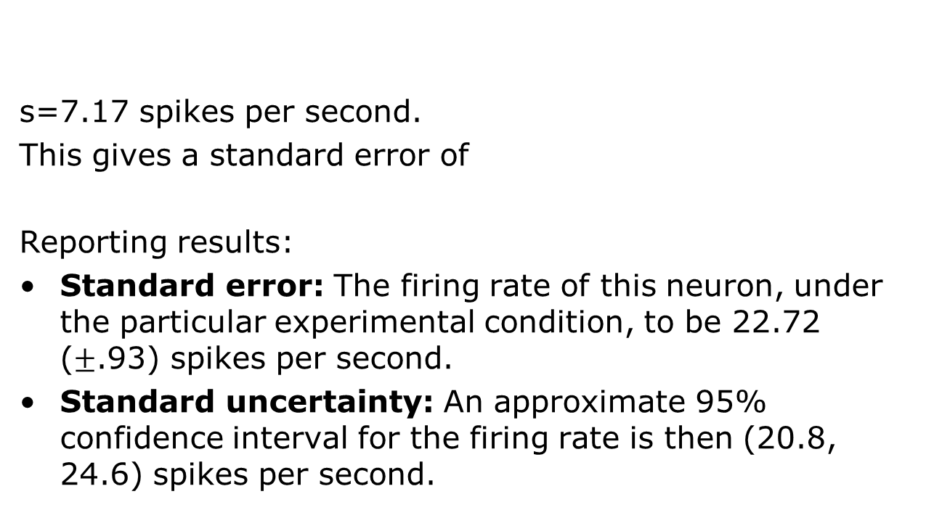
Example – Spike counts from a motor cortical neuron, cont.
s=7.17 spikes per second.
This gives a standard error of
Reporting results:
Standard error: The firing rate of this neuron, under the particular experimental condition, to be 22.72 ($±$.93) spikes per second.
Standard uncertainty: An approximate 95% confidence interval for the firing rate is then (20.8, 24.6) spikes per second.
R. E. Kass, et. al., “Analysis of Neural Data,”
Springer 2014

Slide 52
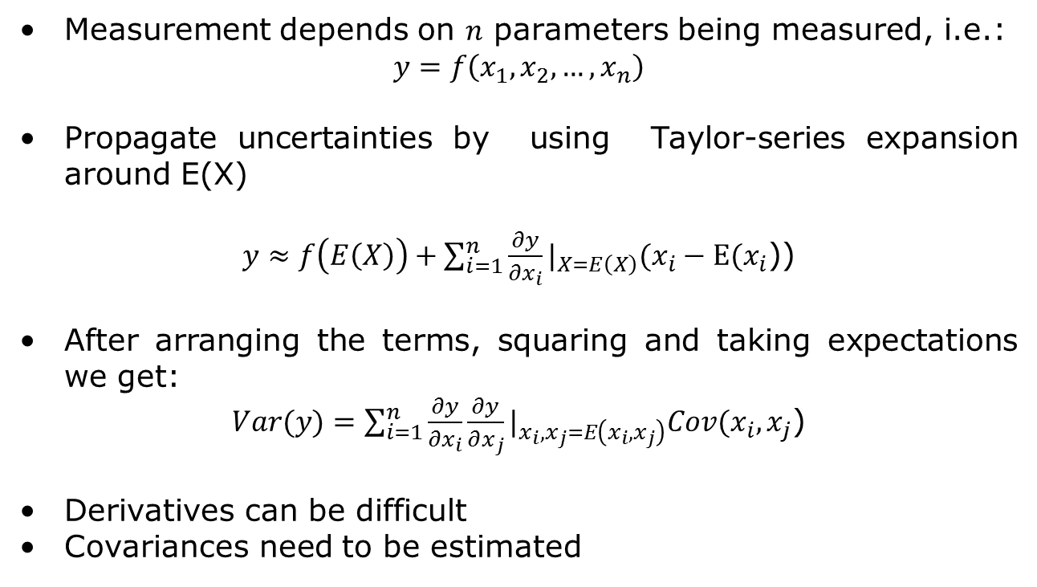
Perturbation methods
Measurement depends on $n$ parameters being measured, i.e.:
$$y=f\left(x_{1},x_{2},…,x_{n}\right)$$
Propagate uncertainties by using Taylor-series expansion around E(X)
$y≈f\left(E\left(X\right)\right)+\sum_{i=1}^{n}{\frac{∂y}{∂x_{i}}}|_{X=E\left(X\right)}(x_{i}−E(x_{i}$))
After arranging the terms, squaring and taking expectations we get:
$Var(y)=\sum_{i=1}^{n}{\frac{∂y}{∂x_{i}}}\frac{∂y}{∂x_{j}}|_{x_{i},x_{j}=E\left(x_{i},x_{j}\right)}Cov(x_{i},x_{j}$)
Derivatives can be difficult
Covariances need to be estimated

Slide 53
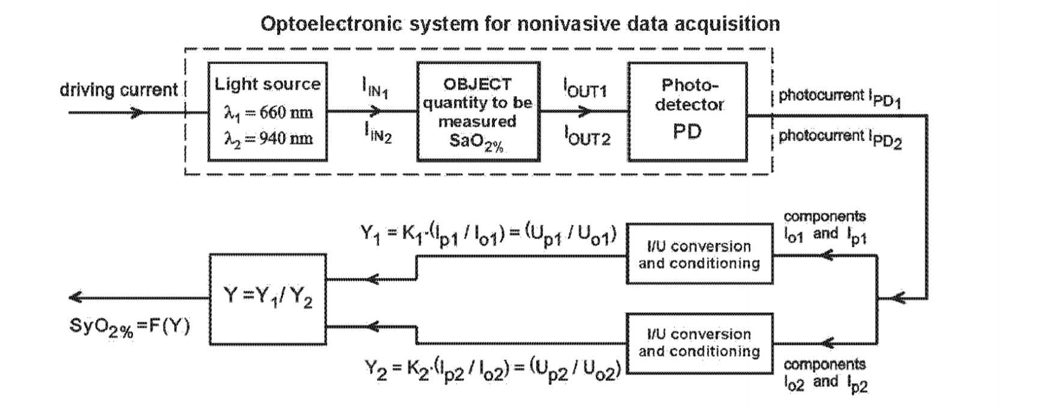
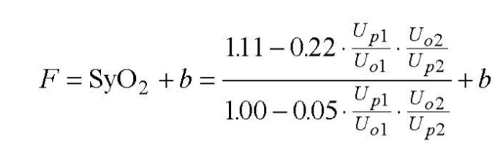
Example - Metrological aspects of pulse oximeter
A. Cysewska-Sobusiak, "Estimation of Uncertainty in Complex Biomeasurements," IEEE Workshop on Advanced Methods for Uncertainty Estimation in Measurement, 2007, pp. 24-29.
Notes:
A. Cysewska-Sobusiak, "Estimation of Uncertainty in Complex Biomeasurements," 2007 IEEE International Workshop on Advanced Methods for Uncertainty Estimation in Measurement, Sardagna, 2007, pp. 24-29.

Slide 54
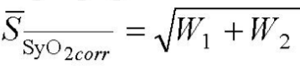
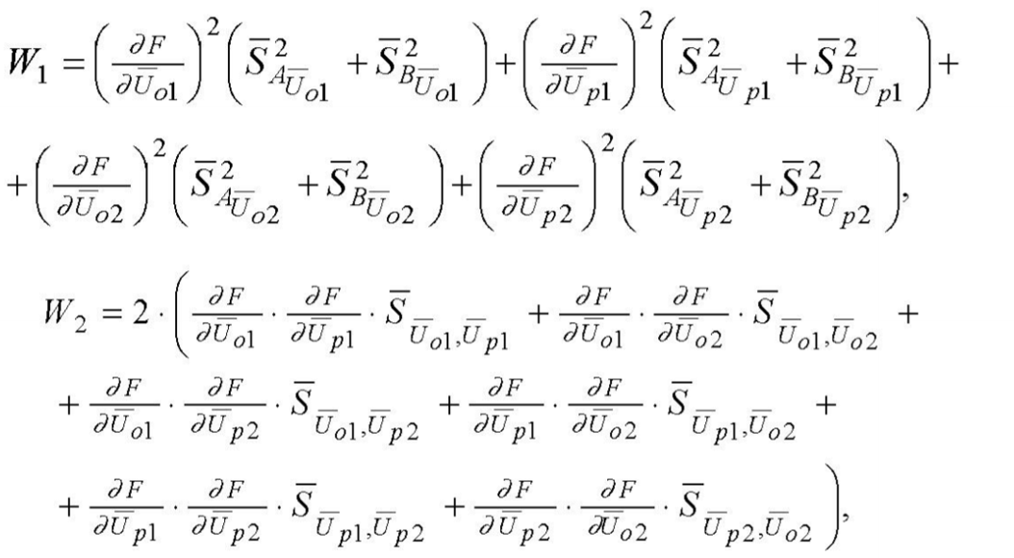
Computing the uncertainty

Slide 55
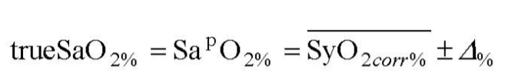
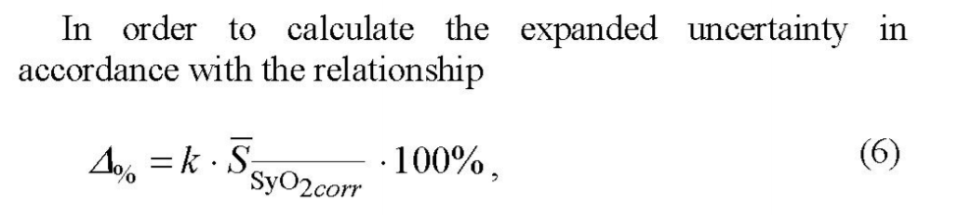
Results

Slide 56
Other statistical intervals
Prediction intervals
An intervals that would contain a future randomly selected observation from the distribution, with a specific degree of confidence.
Example: predict sample mean of m future samples
Statistical tolerance limits create an interval that bounds a specified percentage of the population at a given level of confidence.
(such as 99% of the population with 95% confidence)
These intervals are often used to demonstrate compliance with a set of requirements or specification limits.
Notes:
Confidence intervals – analyse the already collected data
Prediction intervals is estimating future estimate (for example, based on consumption of gas from a sample of 5 cars, obtain an interval that contains, with a degree of confidence, the gas consumption of a new car that will operate under specified driving conditions.)
Prediction intervals are useful to predict the performance of one or several of future units. If we would like to estimate performance of large number of units based on a small sample, then instead of computing the confidence interval that contains all of a specified number of units, it is sufficient to construct an interval that contains a large proportion of such units.

Slide 57
Outline
Motivation
Introduction
Uncertainty framework
Biomedical examples
Confidence intervals and traditional GUM based approach
Bayesian methods and Monte Carlo methods
Application in uncertainty propagation and sensitivity analysis
Bootstrap methods
Application in obtaining confidence intervals in data fitting and for estimation for time-series
Conclusion

Slide 58
Bayesian inference method
Model for data
Likelihood
Data
Bayes theorem
Posterior distribution
Inference
Prior information
By knowing posterior distribution all kinds of estimates can be computed:
W. Q. Meeker, et. al., “Statistical intervals, A Guide for Practitioners and Researchers,” Second Edition, Wiley, 2017
Notes:
From “Statistical intervals: Guide for practitioners”

Slide 59
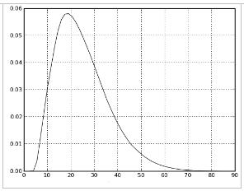
Credible intervals
Interpretation: the probability that the true mean is contained within the given interval is 95%.
95% probability the parameter is here
Posterior
Distribution
2.5%
2.5%

Slide 60
Monte Carlo methods
Use
Solving integrals
Propagating uncertainties
Sequential Monte Carlo methods for parameter estimation
Solution
Problem
Estimate
posterior
Integrals are
not tractable
Monte Carlo
Sampling
Difficult to
draw samples
Importance
Sampling

Slide 61
Evaluating integrals using Monte Carlo methods
Example: Estimate the variance of a zero mean Gaussian process
Monte Carlo approach:
Simulate M random variables from a Gaussian distribution
Compute the average

Slide 62
Importance sampling
Classical Monte Carlo integration – Difficult to draw samples from the desired distribution
Importance sampling solution:
Draw samples from another (proposal) distribution
Weight them according to how they fit the original distribution
Free to choose the proposal density
Important:
It should be easy to sample from the proposal density
Proposal density should resemble the original density as closely as possible

Slide 63
Importance sampling
Evaluation of integrals
Monte Carlo approach:
Simulate M random variables from proposal density π(x)
Compute the average

Slide 64
Bayesian Uncertainty Quantification
Issues to be considered
Selection of prior PDFs
Ranking the alternative models in order to select the best model
Incorporating measurement and calibration uncertainties
Real-time processing

Slide 65
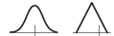
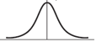
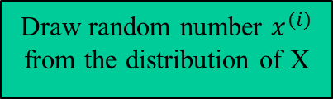
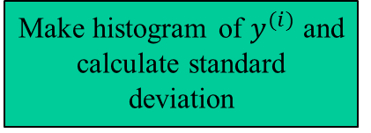
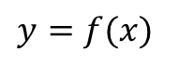
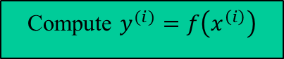
Step C’: Propagation of uncertainties based on Monte Carlo
Propagate of uncertainties “through” function f
Distribution of measurement errors and input uncertainties has been determined
Works for non-linear models
Disadvantages
Slow convergence
Draw random number $x^{(i)}$ from the distribution of X
$$y=f(x)$$
Compute $y^{(i)}=f\left(x^{\left(i\right)}\right)$
i=M
Make histogram of $y^{(i)}$ and calculate standard deviation
Notes:
Distribution of measurement errors and input uncertainties has been determined – experimentally or using Bayesian methods

Slide 66
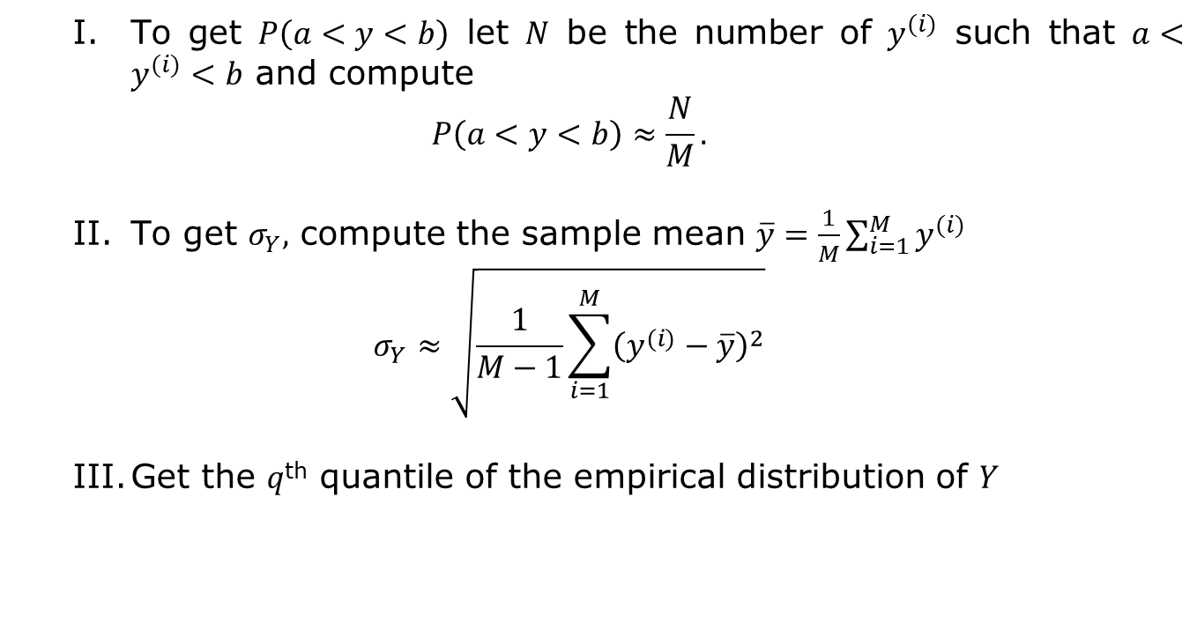
Monte Carlo based propagation of uncertainty
To get $P\left(a<y<b\right)$ let $N$ be the number of $y^{(i)}$ such that $a<y^{(i)}<b$ and compute
$$P\left(a<y<b\right)≈\frac{N}{M}.$$
To get $σ_{Y},$ compute the sample mean $\overline{y}=\frac{1}{M}\sum_{i=1}^{M}{y^{(i)}}$
$$σ_{Y}≈\sqrt{\frac{1}{M−1}\sum_{i=1}^{M}{{\left(y^{(i)}−\overline{y}\right)}^{2}}}$$
Get the $q$^{th} quantile of the empirical distribution of $Y$
Notes:
Analysis of Neural Data

Slide 67
Sensitivity analysis with Monte Carlo simulations
Generate samples from a parameter space
Which distribution we chose?
Is every parameter combination equally meaningful?
Pass the parameters to the model
Measure association between the result and each parameters
Matlab sensitivity toolbox

Slide 68
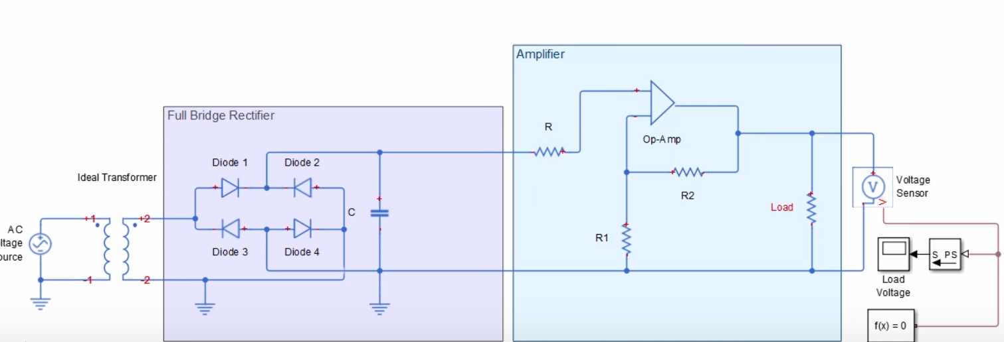
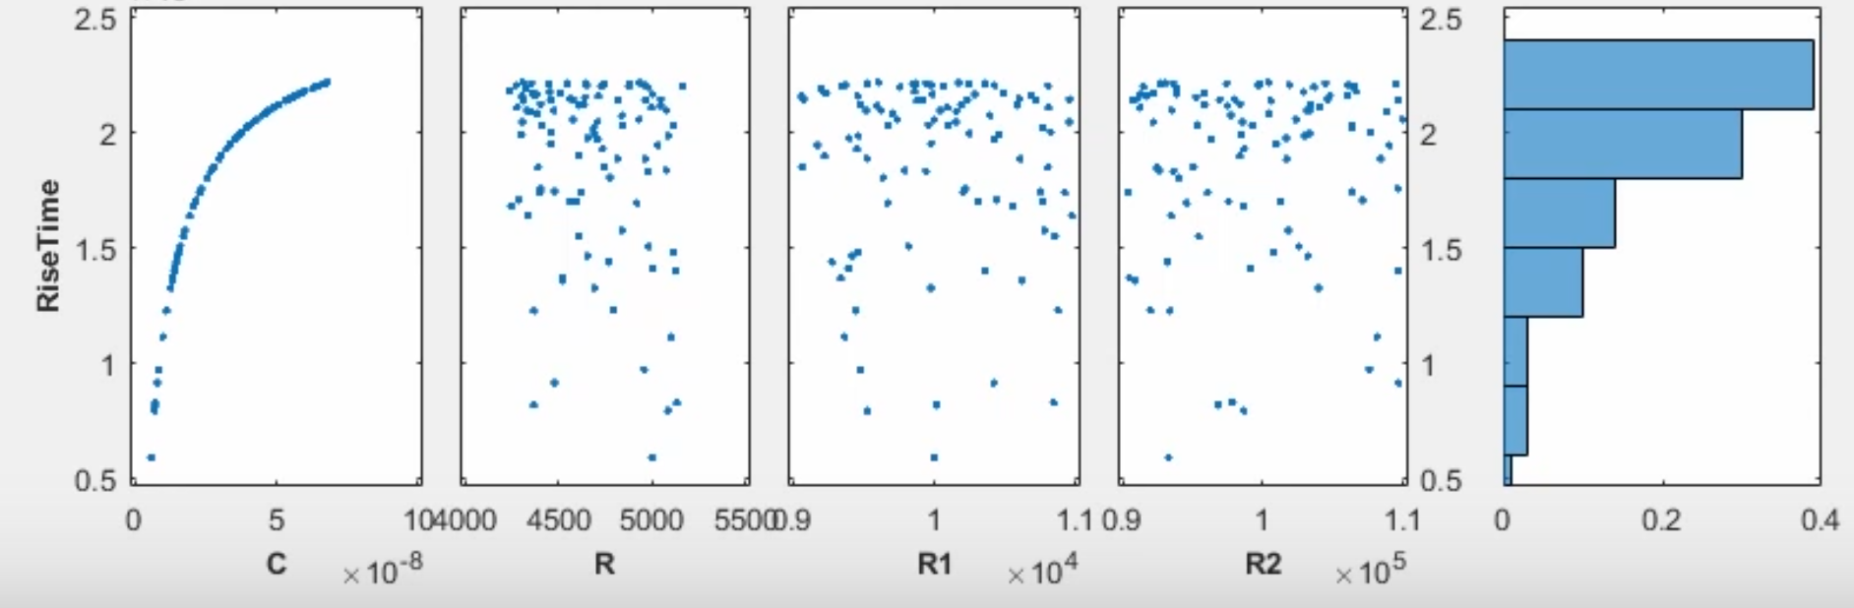
Sensitivity analysis
Objective: Minimize the rise time of the voltage at the output by looking at the parameters C, R1, R2 and R3
Notes:
Source: Design Exploration Using the Sensitivity Analysis Tool, Matlab, https://www.youtube.com/watch?v=hNweoL4l97w

Slide 69
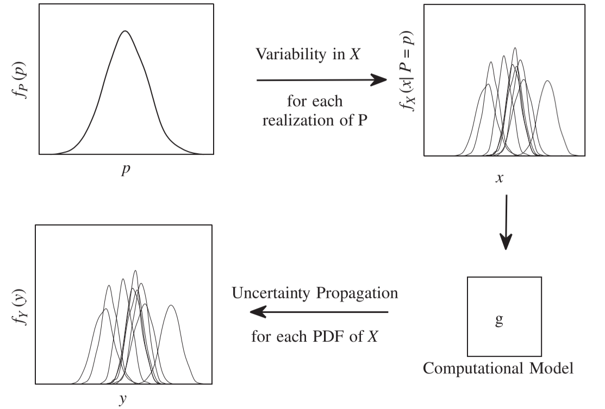
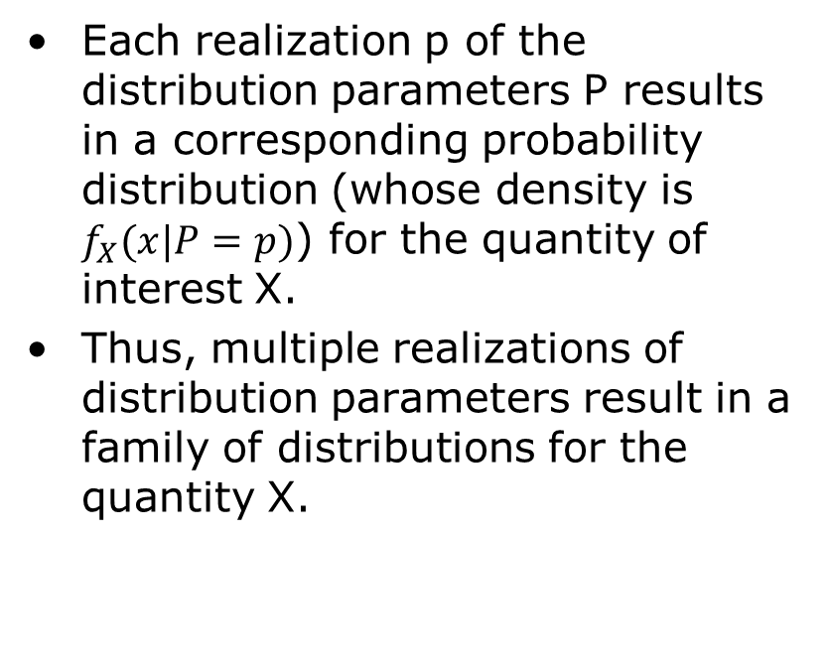
Including variability and parameter uncertainty in sensitivity analysis
Each realization p of the distribution parameters P results in a corresponding probability distribution (whose density is $f_{X}(x|P=p)$) for the quantity of interest X.
Thus, multiple realizations of distribution parameters result in a family of distributions for the quantity X.
S. Sankararaman, S. Mahadevan, Separating the contributions of variability and parameter uncertainty in probability distributions, Reliability Engineering and System Safety, 112 (2013) 187–199.

Slide 70
Outline
Motivation
Introduction
Uncertainty framework
Biomedical examples
Confidence intervals and traditional GUM based approach
Bayesian methods and Monte Carlo methods
Application in uncertainty propagation and sensitivity analysis
Bootstrap methods
Application in obtaining confidence intervals in data fitting and for estimation for time-series
Conclusion

Slide 71
Bootstrap
Bootstrap is a Monte Carlo method of simulating `datasets' from an observed/given data, without any assumption about parameters or models.
Resampling the original data preserves (adaptively) whatever distributions are truly present.
Bootstrap helps evaluate statistical properties using data rather than an assumed Gaussian or other distributions.
It is not a substitute to getting more data to improve accuracy
Useful for providing confidence intervals for median, correlation coefficient, … for which it is difficult to compute analytical confidence intervals
Notes:
From presentation: Model Fitting, Bootstrap, & Model Selection by G. Jogesh Babu
Very good course notes : STA 621: Nonparametric Statistics
Bootstrap Confidence Intervals, Patrick Breheny, http://web.as.uky.edu/statistics/users/pbreheny/621/F10/notes/9-21.pdf

Slide 72
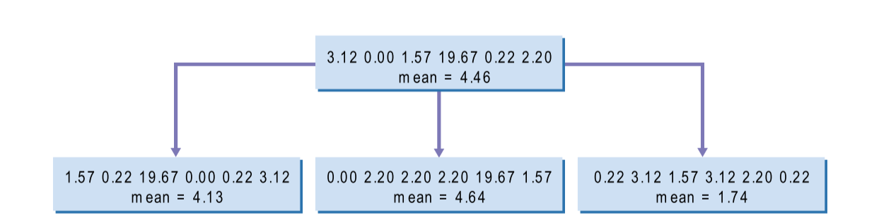
Bootstrap examples
T. Hesterberg, et.al. “Bootstrap Methods and
Permutation Tests,” chapter in The practice of
Business Statistics, W.H. Freeman, NY, 2003

Slide 73
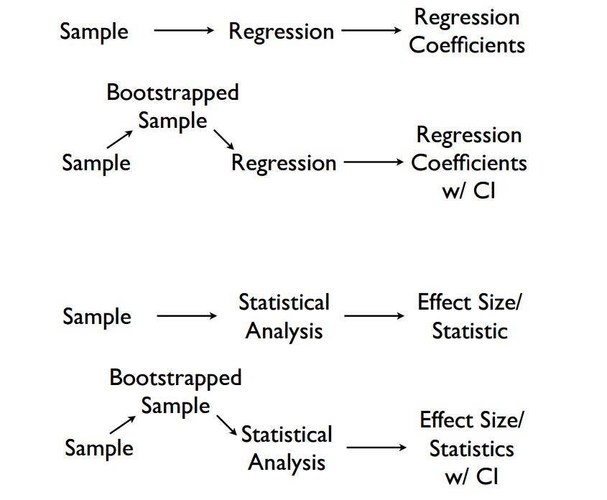
Bootstrap: some applications

Slide 74
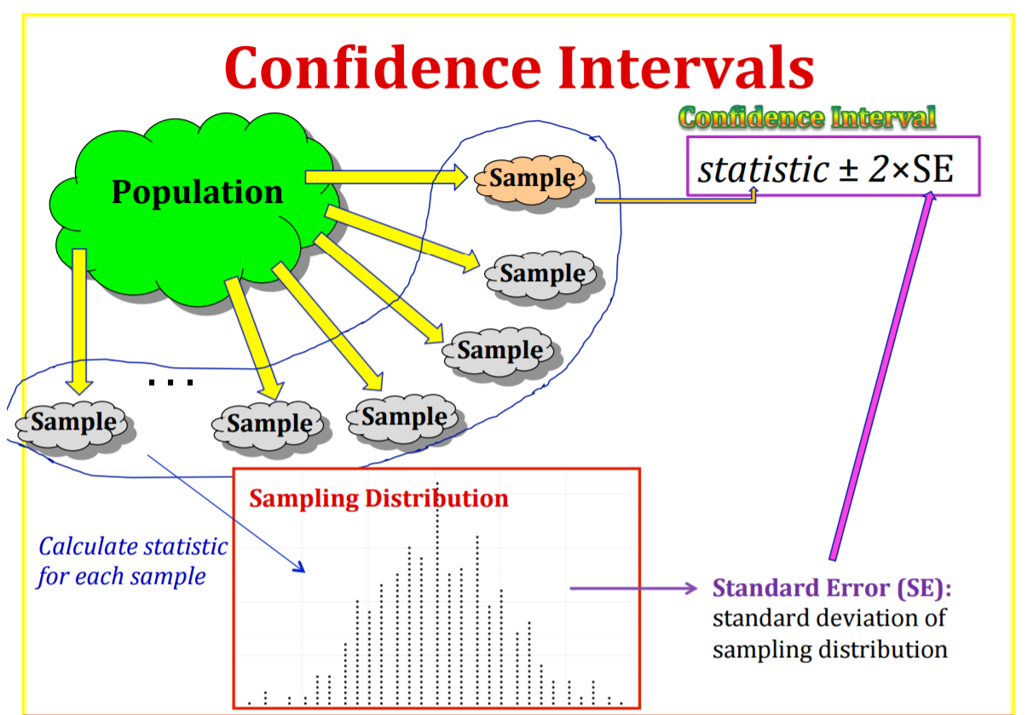
K. L. Morgan, Bootstrap Intervals, Course notes,
PSU 016, 2014

Slide 75
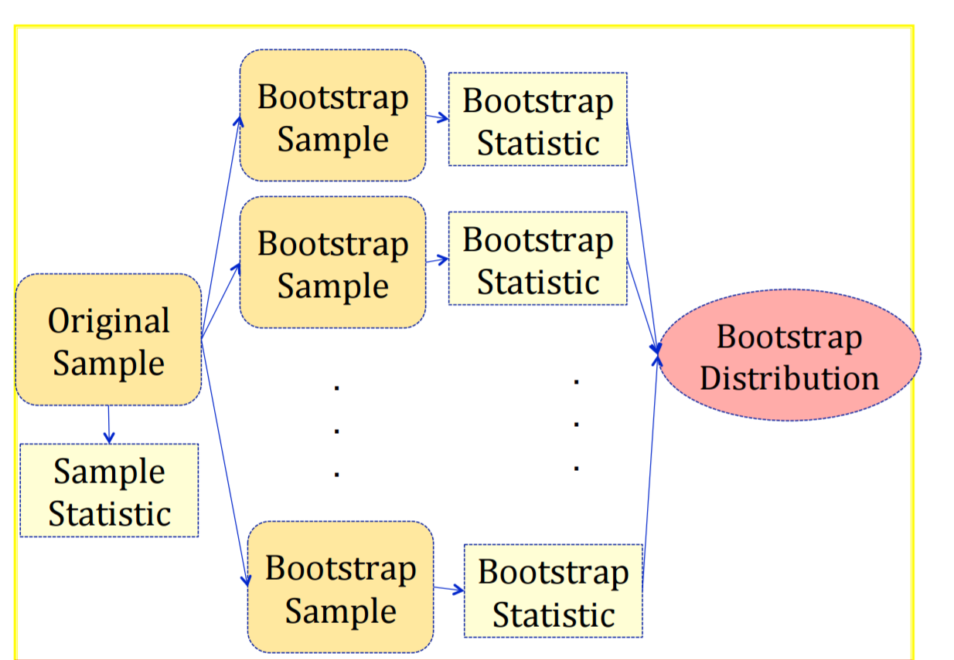
Notes:
A bootstrap sample is a random sample taken with replacement from the original sample, of the same size as the original sample A bootstrap statistic is the statistic computed on a bootstrap sample A bootstrap distribution is the distribution of many bootstrap statistics

Slide 76
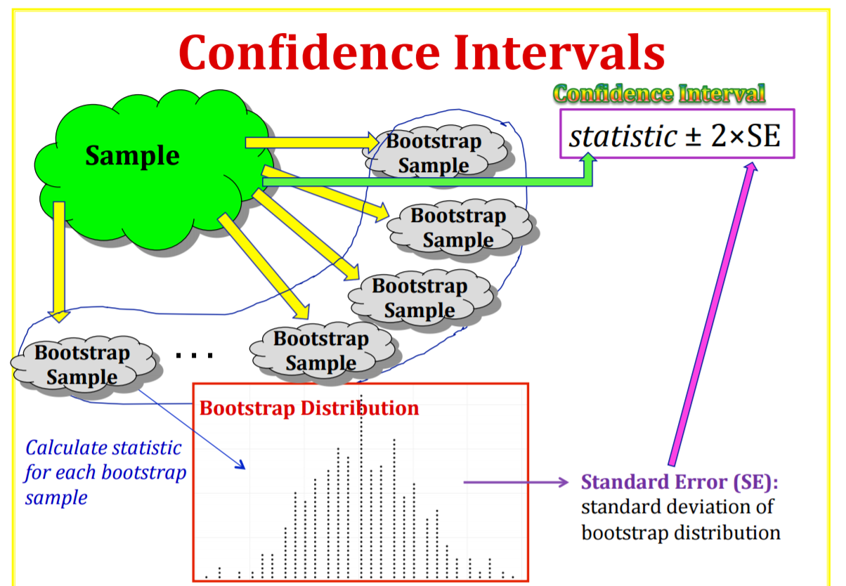
K. L. Morgan, Bootstrap Intervals, Course notes, PSU 016, 2014

Slide 77
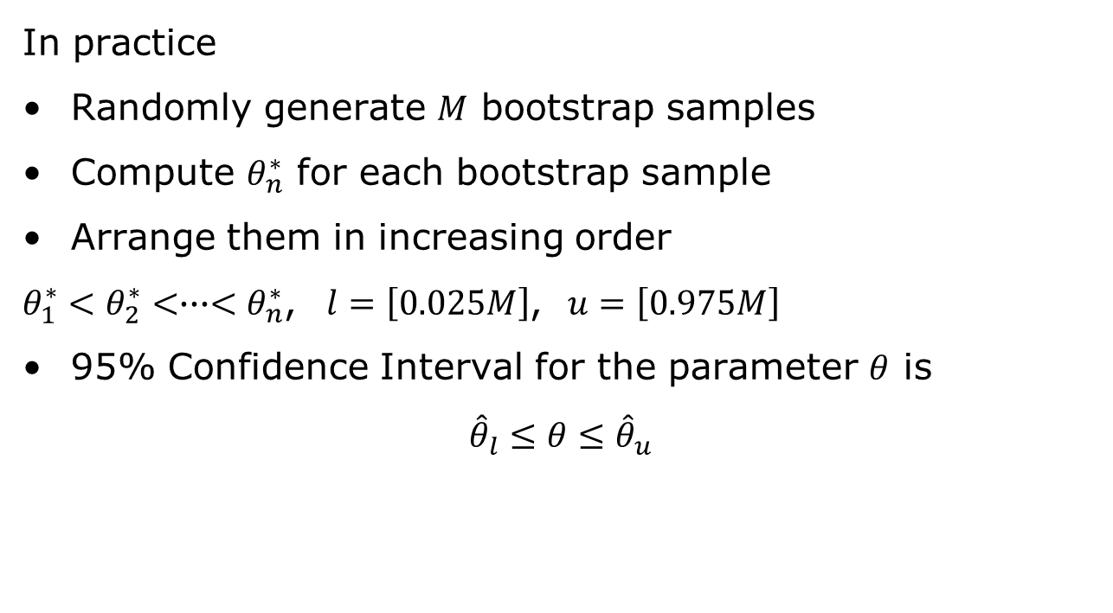
Bootstrap percentile confidence interval
In practice
Randomly generate $M$ bootstrap samples
Compute $θ_{n}^{∗}$ for each bootstrap sample
Arrange them in increasing order
$θ_{1}^{∗}<θ_{2}^{∗}<∙∙∙<θ_{n}^{∗}$, $l=\left[0.025M\right]$, $u=\left[0.975M\right]$
95% Confidence Interval for the parameter $θ$ is
$${\hat{θ}}_{l}≤θ≤{\hat{θ}}_{u}$$
Notes:
From presentation: Model Fitting, Bootstrap, & Model Selection by G. Jogesh Babu

Slide 78
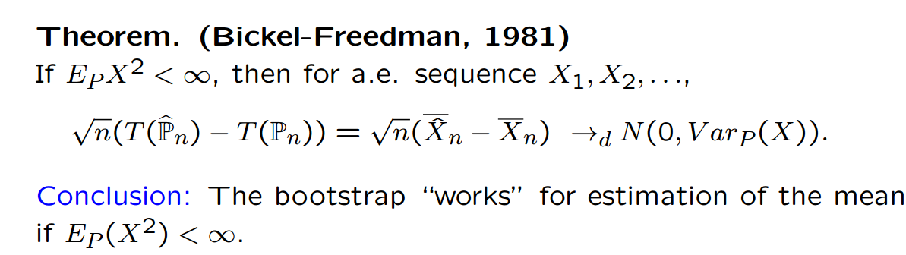
Bootstrap accuracy
Bootstrap distributions and estimates based on them include two main sources of random variations:
The original sample is chosen at random
Bootstrap samples are chosen at random from the original sampl
Bootstraping the mean – limit theory
Jon A. Wellner, “Bootstrap Limit Theory,” Research
Day Talk, University of Washington September 27, 2010
Notes:
https://www.stat.washington.edu/jaw/RESEARCH/TALKS/ResDay.10_small.pdf

Slide 79
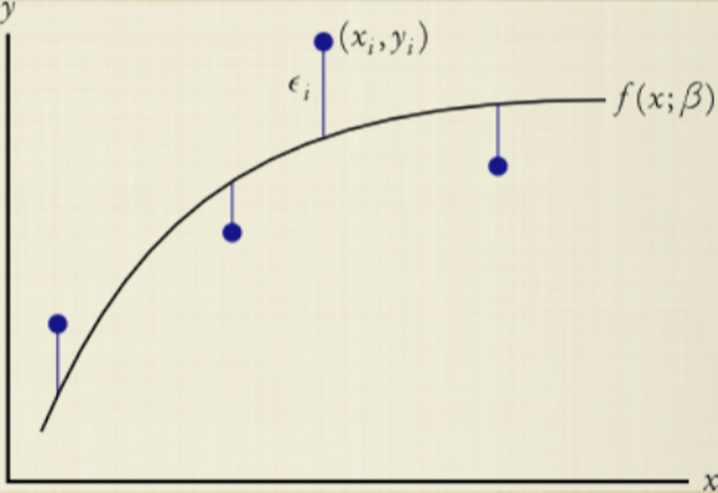
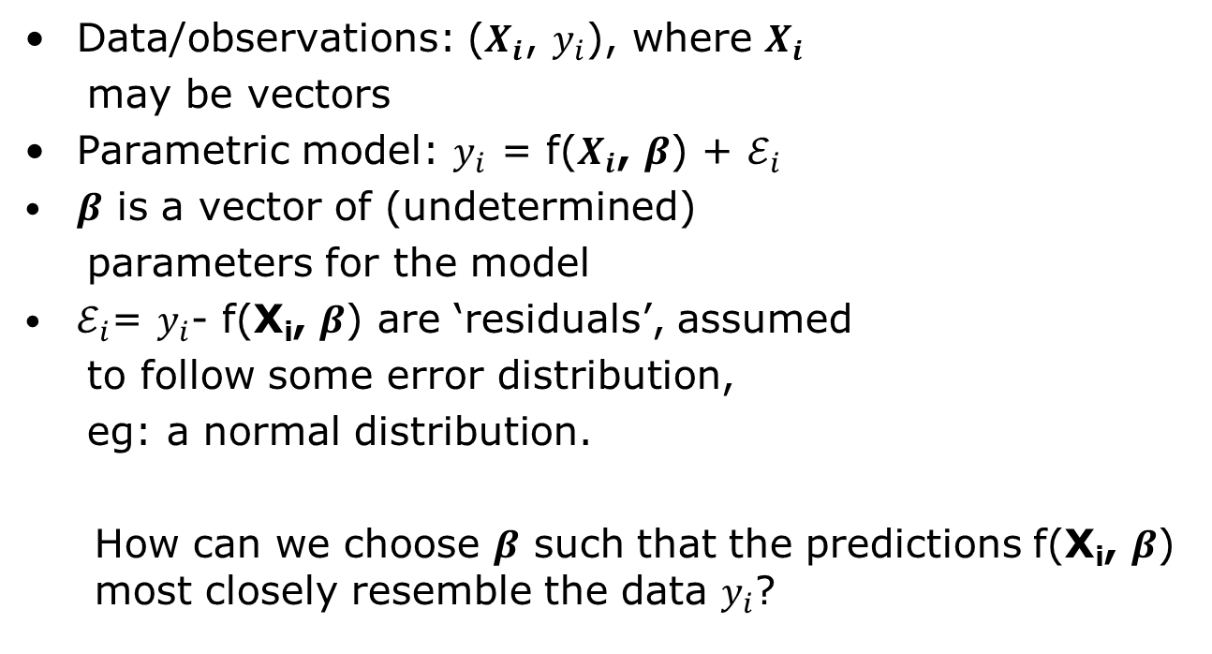
Model calibration: The likelihood of a model
Data/observations: ($X_{i}$, $y_{i}$), where $X_{i}$
may be vectors
Parametric model: $y_{i}$ = f($X_{i}$, $β$) + $ℰ_{i}$
$β$ is a vector of (undetermined)
parameters for the model
$ℰ_{i}$= $y_{i}$- f(X_{i}, $β$) are ‘residuals’, assumed
to follow some error distribution,
eg: a normal distribution.
How can we choose $β$ such that the predictions f(X_{i}, $β$) most closely resemble the data $y_{i}$?
Modified from: D. Das, “Experimental data analysis,”
Lecture slides.

Slide 80
Likelihood maximization
Data fitting = Likelihood maximization
Define the likelihood of a model, given some data:
‘Fitting’ the data to the model is equivalent to maximizing this likelihood function with respect to the model parameters
Modified from: D. Das, “Experimental data analysis,”
Lecture slides.

Slide 81
Likelihood maximization for normal errors
Therefore, maximizing the likelihood function is equivalent to minimizing the sum of squared residuals:
Last squares regressions Likelihood maximization assuming independent, normally distributed measurement errors. The maximum-likelihood parameter estimate is defined as
Modified from: D. Das, “Experimental data analysis,”
Lecture slides.

Slide 82
Nonlinear Regression
The model is a nonlinear function of the parameters.
We can still write down the likelihood as before.
But the maximum likelihood equations cannot be solved analytically.
Accessing the quality of fit: random distribution of residuals
where SST is the total sum of squares (SST),
Modified from: D. Das, “Experimental data analysis,”
Lecture slides.

Slide 83
Computing confidence intervals for the parameter estimates
Asymptotic confidence intervals
Based on an analytical approximation
Bootstrap confidence intervals
Computation based on resampling the error
Modified from: D. Das, “Experimental data analysis,”
Lecture slides.

Slide 84
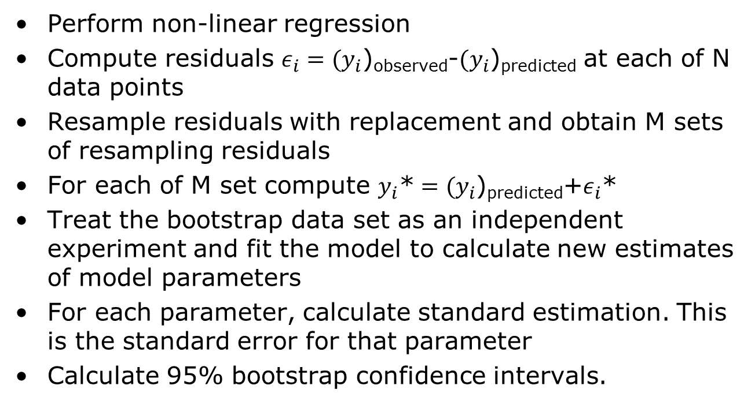
Model calibration with bootstrap confidence intervals
Perform non-linear regression
Compute residuals $ε_{i}={(y}_{i}$)_{observed}-${(y}_{i}$)_{predicted} at each of N data points
Resample residuals with replacement and obtain M sets of resampling residuals
For each of M set compute $y_{i}\text{∗}={(y}_{i}$)_{predicted}+$ε_{i}$*
Treat the bootstrap data set as an independent experiment and fit the model to calculate new estimates of model parameters
For each parameter, calculate standard estimation. This is the standard error for that parameter
Calculate 95% bootstrap confidence intervals.

Slide 85
Outline
Motivation
Introduction
Confidence intervals
Monte Carlo methods
Bootstrap methods
Conclusion
Some interesting approaches
Uncertainty in the cloud
Resources
Courses
Books
References

Slide 86
Uncertainty related resources - Tools
SimLab
https://ec.europa.eu/jrc/en/samo/simlab
OpenTurns
http://www.openturns.org/
C++ with Python wrappers
UQLab
http://www.uqlab.com/
Matlab
MIT Uncertainty Quantification Library (MUQ)
C++
…

Slide 87
Uncertainty related resources - Courses
With Videos
Uncertainty Quantification in Engineering Science
http://eclass.uth.gr/eclass/courses/MHXB124/
Introduction to Uncertainty Quantification
https://www.ima.umn.edu/2014-2015/ND6.15-26.15/#
Without videos
MA 540 Uncertainty Quantification for Physical and Biological Models
http://www4.ncsu.edu/~rsmith/MA540_s17.html

Slide 88
Uncertainty related resources - Books
F. Pavese, A. B. Forbes, Data Modeling for Metrology and Testing in Measurement Science, Springer, 2009.
S. V. Gupta, Measurement Uncertainties, Physical Parameters and Calibration of Instruments, Springer-Verlag Berlin Heidelberg 2012.
I. Lira, Evaluating the Measurement Uncertainty: Fundamentals and Practical Guidance, IoP 2002.
H. W. Coleman, W. G. Steele, Experimentation, validation and uncertainty analysis for Engineers, Wiley, 2009.
A. Zoubir, D. R. Iskander, Bootstrap techniques for signal processing, Cambridge University Press, 2004.
W. Q. Meeker, G. J. Hahn, L. A. Escobar, Statistical Intervals: A Guide for Practitioners and Researchers, 2nd Edition, Wiley, 2017.
R. C. Smith, Uncertainty Classification: Theory, Implementation and Applications, SIAM, 2014.
K. Beven, Environmental Modelling: An Uncertain Future?, Taylor & Francis e-Library, 2010.

Slide 89
References
Sankaran Mahadevan, “Modeling and Data Uncertainties,” presentation, NASA/NAI Summer Design Institute on Uncertainty, Hampton, VA, July 20, 2011
William F. Guthrie,1 Hung-kung Liu,2 Andrew L. Rukhin,3 Blaza Toman, Jack C. M. Wang,5 Nien fan Zhang, Three Statistical Paradigms for the Assessment and Interpretation of Measurement Uncertainty, from Data Modeling for Metrology and Testing in Measurement Science by Franco Pavese and Alistair B. Forbes
BIPM, IEC, IFCC, ISO, IUPAC, IUPAP, and OIML. Guide to the expression of uncertainty in
measurement, International Organization for Standardization. GUM 1995 with minor corrections. Corrected version 2010. JCGM 100:2008.
BIPM, IEC, IFCC, ISO, IUPAC, IUPAP, and OIML. Evaluation of measurement data — Supplement 1 to the Guide to the expression of uncertainty in measurement — Propagation of distributions using a Monte Carlo method. JCGM 101:2008.

